Slide 1
Policing the TEEN BRAIN in SCHOOL
New York State Regional Leadership
Summit on School-Justice Partnerships

Slide 2
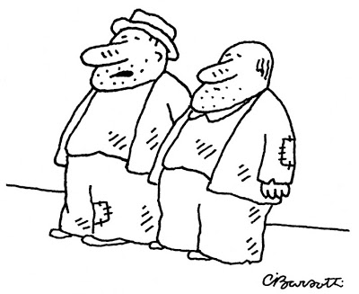
Paradigm Changes
Recognition:
--Same old/same old won’t work now
--May not have worked previously.
--Pay now, pay later.
“Good news, I hear the paradigm is shifting.”

Slide 3
Session Will Discuss
Policing the Teen Brain in School
Identify Sources of Current Paradigm Shifts
Advocates
U.S. Supreme Court
Schools
Parents
Absence of Training
Value of taking Developmental Approach

Slide 4
First Responders for Discipline

Slide 5
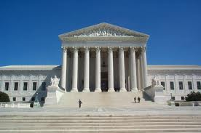
Legal Landscape
Roper v. Simmons (‘05)
Graham v. Florida (‘10)
Miller v. Alabama (‘12)
JDB v. N. Carolina (‘11)

Slide 6
Roper v. Simmons (2005)
“A lack of maturity and an underdeveloped sense of responsibility are found in youth more often than in adults…often result in impetuous and ill-considered actions and decisions…that “adolescents are overrepresented statistically in virtually every category of reckless behavior.”

Slide 7
Roper v. Simmons, cont’d.
Youth “are more vulnerable or susceptible to negative influences and outside pressures, including peer pressure…”
“…Character of a juvenile is not as well formed as that of an adult. The personality traits of juveniles are more transitory, less fixed.
Therefore:
“The susceptibility of juveniles to immature and
irresponsible behavior means ‘their irresponsible
conduct is not as morally reprehensible as that of an
adult.’” Cannot be sentenced to death.

Slide 8
JDB v. North Carolina, 2011
“[O]fficers and judges need no imaginative
powers, knowledge of developmental psychology,
training in cognitive science, or expertise in social
and cultural anthropology to account for a child’s
age. They simply need the common sense to know
that a 7-year-old is not a 13-year-old and neither is
an adult.”

Slide 9
Policy Pressures Today
US Department of Justice
Reduced use of incarceration
Trauma Informed Approaches
End use of “scared straight”
JJDPAct
Disproportionate Minority Contact (DMC)
Police Role

Slide 10
This Just In…
January 9, 2014 from U.S. Department of Ed
issues “guidance” on Improving School
Climate and Discipline.
Prevention
Clear, Appropriate & Consistent Expectations & Consequences
Equity & Continuous Improvement

Slide 11
School Systems are expected to…
Reduce school-based arrests
Train officers and school personnel in developmentally appropriate approaches to positively engage with youth.
Developmentally appropriate & proportional consequences for misbehavior
Reduce use of suspensions/expulsions.
Apply all adult conduct in unbiased manner.

Slide 12
And If Schools Don’t…Expect
To have your data collected!
Enforcement actions!
Source: http://www.ed.gov/school-discipline/

Slide 13
How do we prepare police to work with youth?

Slide 14
The youth you see...

Slide 15
In-Service Police Training
IACP 2011 Juvenile Justice
Training Needs Survey of
Chiefs:
No training after academy,
No requirement for in-service training,
No in-service training in juvenile justice for 5 years or > due to lack of funding.

Slide 16
Academy Recruit Training
SFY Study of Police Officer
Standards & Training (POST)
Curriculum 2013:
Average duration is 6 hours,
90 to 95% of curricula is legal; not always updated,
Most state provide no training on youths’ developmental and mental health issues.

Slide 17
Teens’ Enlarged Amygdala: No Braking Device

Slide 18
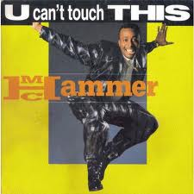
Developmental Competence
Juvenile developmental
characteristics such as
impulsivity, self
centeredness, and
resistance to authority
Increase the chances that
police-juvenile encounters
will involve conflict,
disrespect, and
confrontational behavior.

Slide 19
Developmental Competence
Universal stages of development
Adults & institutions working with children & youth must:
Understand
Apply the Knowledge
Adjust Responses

Slide 20
Making the Case…

Slide 21
Costs
Pressure to reduce use of detention and incarceration
Fewer law enforcement resources
Officers out of service
Court costs/OT

Slide 22
Risk Management
Media coverage
Legal Challenges & Costs:
Legal fees
Department legitimacy
Community relations
Morale

Slide 23
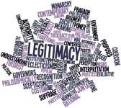
Legitimacy of Law Enforcement
Positive Socialization of youth to relations with authority
Hold your fire!
Don’t dilute police authority
Notes:
Begin with information on cuts to municipalities; every one is hurting and the need to use existing resources carefully and wisely is important and can help ensure that good decisions are made.
You might want to remind officers that recent studies show that arrest and detention of youth is most likely to lead to recidivism; according to one study, this approach to minor youth crime increased SEVEN FOLD the recidivism rate.

