Slide 1
WHEN DID MAKING ADULTS MAD BECOME A CRIME
A Collaborative Approach to Reducing School Arrests and Improving Outcomes

Slide 2
Best Practices Improves Safety
JDAI Reform Begins

Slide 3
Clayton: Total Number of Offenses by Category
JDAI Detention Reform

Slide 4
Don’t let appearances mislead
70% decrease in average daily population;
12.4 average daily population in a 60 bed holding facility;
43% reduction in the average length of stay’
64% reduction in average daily population of minority youth;
43% reduction in commitments to the state;
40% reduction in commitments of minority youth; YET—
60% reduction in juvenile arrests; and
24% increase in overall graduation rates.

Slide 5
The Problem
Zero Tolerance Policies: The Courts, Schools, Police, & Kids

Slide 6
IMPACT OF ZERO TOLERANCE ON SCHOOL CAMPUS
Over 2000% increase in Juvenile Arrests on campus

Slide 7
What is Hyper-recidivism?
When an individual or system responds to an offender using a technique that exacerbates the risk to re-offend

Slide 8
The Solution
Annie E. Casey Juvenile Detention Alternatives Initiative & NCJFCJ New Delinquency Guidelines

Slide 9
Understanding the Role of the Judge--
Is to understand the nature of juvenile justice systems

Slide 10
Understanding the Role of the Judge--
Is to understand the nature of juvenile justice systems

Slide 11
Juvenile Justice System=The Community
COGNITION
PEERS
SCHOOL CONNECTEDNESS
FAMILY FUNCTION
SUBSTANCE ABUSE
WEAK PROBLEM-SOLVING SKILLS
SOCIAL SERVICES
MENTAL HEALTH
COGNITIVE RESTRUCTURING
SCHOOL SYSTEM
MULTI-SYSTEMIC THERAPY
FUNCTIONAL FAMILY THERAPY
PROBATION/COURTS

Slide 12
MULTI-INTEGRATED SYSTEM THEORY
INPUTS
Education
INPUTS
INPUTS
Law Enforcement
OUTPUTS
Social Services
Mental Health
INPUTS

Slide 13
How Collaboration Works?
Applying a systems model to collaborative phenomena requires a shift from organization to the problem domain. When this shift occurs, the nature of the questions also changes. A problem domain-focused as opposed to an organization-focused analysis drives the evaluator to understanding that each stakeholder system sometimes works within a larger system with shared boundaries. Instead of asking how do we address disruptive students, which will lead to punitive measures given the shortfall of resources, the question becomes who else shares our problem and has resources to help us?—Wood & Gray, 1991

Slide 14
Collaboration Defined
Collaboration occurs when a group of autonomous stakeholders of a problem domain engage in an interactive process, using shared rules, norms, and structures, to act or decide on issues related to that domain—Wood & Gray, 1991

Slide 15
Who Convenes?
Convening Power—the ability to bring stakeholders to the table;
Legitimacy—the stakeholders perceive the convener to have authority, formal or informal, within the problem domain;
Vision—the convener understands the problem domain and related issues to process stakeholder concerns and needs; and
Stakeholder Knowledge—the convener can identify the stakeholders and possesses knowledge of each stakeholder role in the problem domain.—Gray, 1989

Slide 16
The Judicial Leadership Model
The juvenile court is the one place where all agencies serving children and youth intersect. The juvenile court is the common denominator of all child service agencies (Teske, 2011). With the juvenile court situated at the crossroads of juvenile justice, the juvenile court judge is placed in a unique role—as the traffic cop! (Teske & Huff, 2011)

Slide 17
Special Role of Juvenile Judge
National Center for State Courts Rehnquist Award for Judicial Excellence in 2004 was awarded to a state juvenile court judge of Santa Clara County, California, Superior Court Judge Leonard Perry Edwards II . Judge Edwards spoke to the special role of the juvenile court judge.
“When parenting fails, when informal community responses are inadequate, our juvenile and family courts provide the state’s official intervention in the most serious cases involving children and families. We are the legal equivalent to an emergency room in the medical profession. We intervene in crises and figure out the best response on a case-by-case, individualized basis. In addition, we have to get off the bench and work in the community. We have to ask these agencies and the community to work together to support our efforts so that the orders we make on the bench can be fulfilled. We have to be the champions of collaboration.
JUDGE LEONARD P. EDWARDS, “The Role of the Juvenile Court Judge Revisited,” Juvenile and Family Court Journal, Winter 2005

Slide 18
Convener vs. Facilitator
Some literature includes neutrality as a convener characteristic, but from our experience in the jurisdictions discussed below, neutrality is not necessary if the convener’s role is limited to bringing stakeholders together. It is difficult to be unbiased if the convener is also a stakeholder, and to exclude a stakeholder from convening a collaborative may be detrimental to initiating action. We recommend that a stakeholder convener identify a neutral facilitator to enage the stakeholders during the “interactive process.”—Teske et al, 2012

Slide 19
The Problem Informs
When Clayton County began its stakeholder meetings, it began with a single objective to reduce school arrests. After the “interactive process,” it became evident that the problem was bigger than school arrests, which led to understanding that the solution was mult-faceted. A convener must understand that the stakeholder’s self-interests and the problem domain’s collective interests are not always clear and distinct (Wood & Gray, 1991). This “interactive process” may present new questions, issues and interests that in turn may lead to identifying other stakeholders who should be at the table. (Teske et al, 2012)

Slide 20
The Questions
What are school administrators to do with disruptive students who no longer referred to the court?;
When should police intervene in school disruption matters?;
How do we identify the underlying problems causing the disruption?;
What do we do to address those problems given the limited capacity and resources of the school?; and
How do we ensure the safety of the schools?

Slide 21
STAKEHOLDERS
Parent
Youth
Court
Prosecutor
Defender
Law Enforcement
Schools
Mental Health
Social Services
NAACP

Slide 22
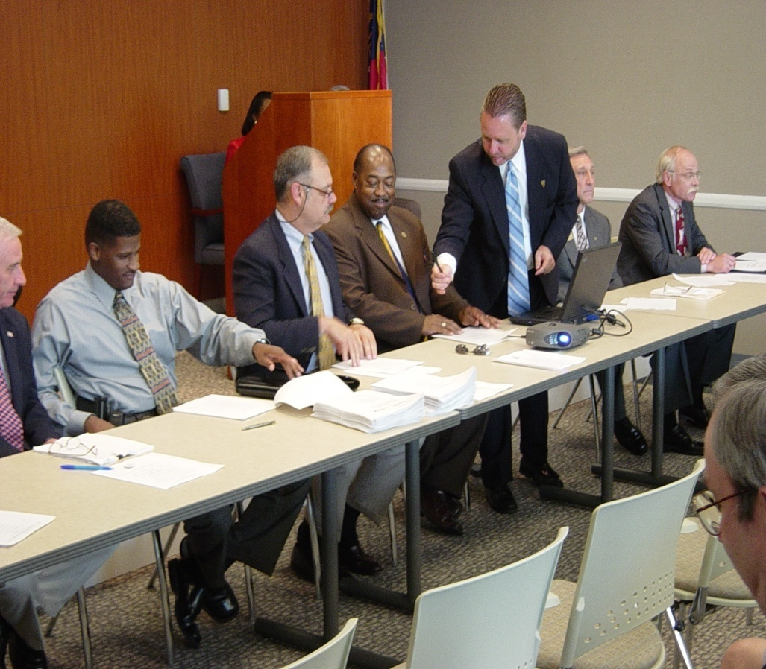
SCHOOL OFFENSE PROTOCOL AGREEMENT
Focused Acts: Affray, DPS, DC, Obstruction
First Offense/Warning
Second Offense/Referral to Workshop
Third Offense/Complaint Filed
School Offense Agreement Signed by all Police Chiefs, School Superintendent, Juvenile Judges, DFCS Director, and other partners on July 8, 2004
Notes:
22

Slide 23
NEW & IMPROVED AGREEMENT
Focused Acts expanded to all misdemenaors except serious bodily injury and drugs;
No referral on special needs without consultation with administrator & counselor in conjunction with intake;
No referral on probationer without consent of probation officer;
Officer has discretion not to refer a felony absent physical injury.

Slide 24
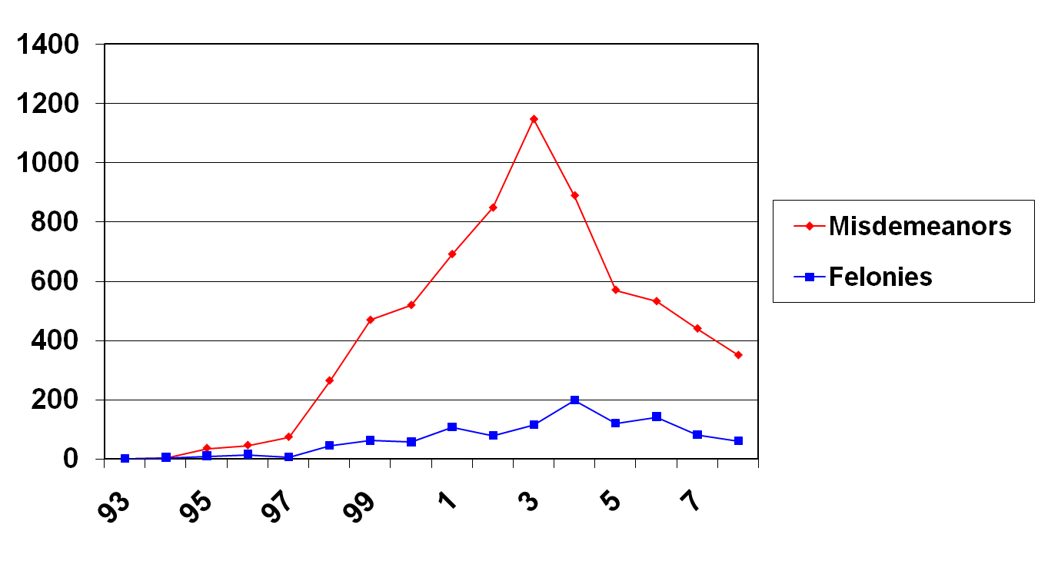
Number of Referrals
Figure 3. Line graph showing the increase in referrals after police placed on campus and the decrease after the protocol became effective in 2004.

Slide 25
Positive Student Engagement Model for School Policing
A different way to increase school & community safety

Slide 26

SRO’s after periodic reviews requested a “Level” box to reflect the use of their discretion to issue another warning or referral in lieu of the next step.
SRO’s also requested the discretion to make a variety of referral, or take other action

Slide 27
“Schools are a microcosm of the community”
Lt. Marc Richards
Supervisor, SRO Unit
Clayton County Police Department

Slide 28
ALLEGORY OF THE SCHOOL
BY OFFICER ROBERT GARDNER
Clayton County Police
LAMBS
SHEEP
WOLVES
THE SCHOOL

Slide 29
PROTOCOL EFFECT ON SCHOOL SAFETY
INCREASES
POLICE
PRESENCE
INCREASES
INTELLIGENCE
DECREASES
WEAPON
CASES
INCREASES
SCHOOL SAFETY
DECREASE
MINOR SCHOOL
REFERRALS
STEP ONE
STEP TWO
STEP FIVE
STEP THREE
STEP FOUR

Slide 30
PROTOCOL INCREASES POLICE INTELLIGENCE

Slide 31
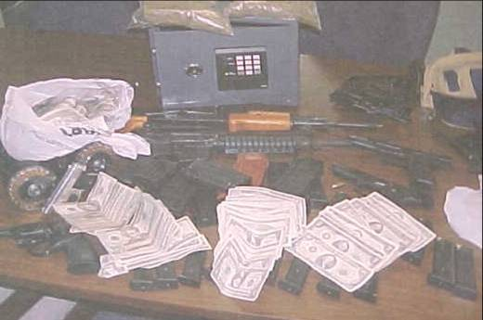
EFFECTIVE USE OF PROTOCOL PROMOTES SAFETY

Slide 32
AVOIDING A TRAGEDY & MEDIA DILEMMA
How will the media & community respond if a person comes on school campus with a gun while your SRO is at intake booking a student for a school fight or disorderly conduct?

Slide 33
System of Care
Bridging the gap between schools and the community

Slide 34
Increase Graduation Rates
Who would ever think that keeping kids in school will increase graduation rates?

Slide 35
THE RESEARCH
Assess Disruptive Students, or why is Johnny disrutive?
Develop Alternatives to Suspension & Referral to Treat the Causes
Increase in Graduation Rates

Slide 36
Multi-System Integrated Services
Governance Structure
Governance
Committee
Advisory Committee
SOC Administrator
SOC Assistant
FAST/Quad C-ST Panel Facilitator

Slide 37
Single Point of Entry
Quad C-ST
School
Mental Health
Social Services
Police
Court

Slide 38
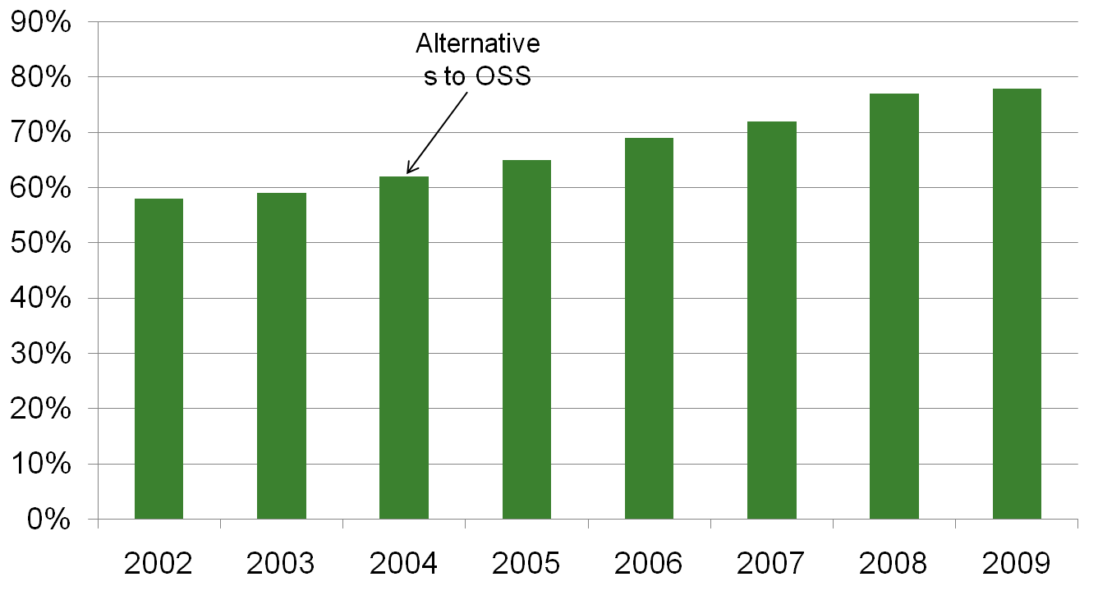
GRADUATION RATES
Protocol :
Pre-Referral
Diversion

Slide 39
PROTOCOL EFFECT ON COMMUNITY SAFETY
DECREASE
MISDEMEANOR
SCHOOL REFERRALS
INCREASE
COMMUNITY
SAFETY
REDUCE
RECIDIVISM
INCREASE
SURVEILLANCE OF
HIGH RISK KIDS
DECREASE
PROBATION
CASELOADS
STEP ONE
STEP TWO
STEP FIVE
STEP THREE
STEP FOUR

Slide 40
REFERRAL BY YOUTH OF COLOR

