Slide 1
Community Schools: A Strategy, Not a Program
Sarah Jonas
Director of Regional Initiatives

Slide 2
Children’s Aid Society
Serves New York's neediest children and families at more than 40 locations.
A Leader in firsts – all CAS initiatives:
first free school lunch program,
first industrial school for poor children,
first day care program for working mothers and
first visiting nurse service
Cutting edge of children’s services
Carrera Adolescent Sexuality and Pregnancy Prevention Program
Community School Model
Foster Care approach and systems

Slide 3
CAS Community Schools
Partner with the New York City Department of Education since 1992
Strategic Opportunity is the Intersection of capacity and need.
16 schools –some have 3 schools in one building (referred to as a “campus model”)
15 public schools, one charter school
2013 NYS Education Commission Report cites as a “Model of Education-Centered Comprehensive Programs”

Slide 4
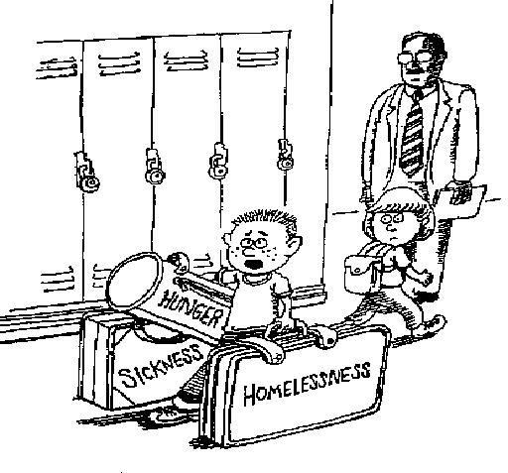
“Could someone help me with these?
I’m late for math class.”
Scott Spencer
Notes:
Kids, just like adults, don’t show up at school automatically ready to learn. They bring with them all sorts of baggage and issues that are getting in the way of good learning.

Slide 5
A Strategy for What?
A strategy for organizing the resources of the community around student success…
Pat Harvey, Former Superintendent
St. Paul Public Schools

Slide 6
What is a Community School?
A community school is both a place and a set of partnerships between the school and other community resources. Its integrated focus on academics, services, supports and opportunities leads to improved student learning, stronger families and healthier communities.
Coalition for Community Schools

Slide 7
Another Definition…
A community school is characterized by:
Extended Services
Extended Hours
Extended Relationships (“swinging door”)

Slide 8
CAS Developmental Triangle
CORE INSTRUCTIONAL PROGRAM
Community
EXPANDED LEARNING OPPORTUNITIES
Family
Child
COMPREHENSIVE SUPPORT SERVICES

Slide 9
Results of CAS Community Schools
Improved academic performance—ELA and Math
Higher attendance rates—Students and Teachers
Positive school climate
Improved school safety
Greater parent involvement
Improved student-teacher relationships
Community benefits, such as better use of public buildings and safer neighborhoods
Teachers able to focus on education

Slide 10
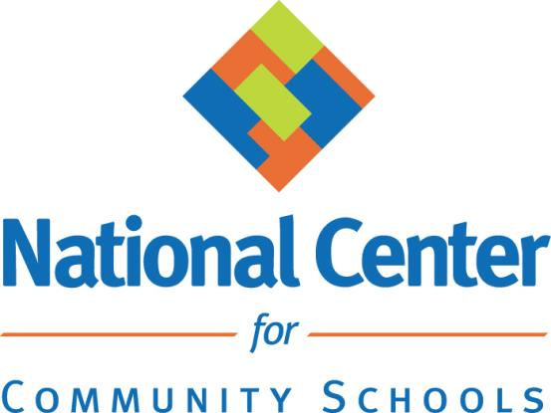
nationalcenterforcommunityschools.org

