Slide 1
Community Schools: A Strategy, Not a Program
Sarah Jonas
Director of Regional Initiatives

Slide 2
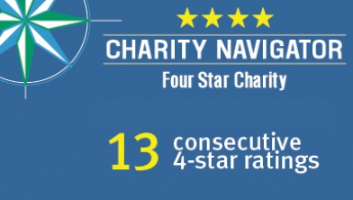
Children’s Aid Society
Children’s Aid Society
Receives 13th Consecutive
4-Star Rating from Charity
Navigator
Mission: The Children’s Aid Society helps children in poverty to succeed and thrive.
We have been serving children for over 160 years. In 1853, CAS founder, Charles Loring Brace, established the Orphan Train Movement in response to an epidemic of homeless children.

Slide 3
Children’s Aid Society
Serves New York's neediest children and families at more than 40 locations.
A Leader in firsts – all CAS initiatives:
first free school lunch program,
first industrial school for poor children,
first day care program for working mothers and
first visiting nurse service
Cutting edge of children’s services
Carrera Adolescent Sexuality and Pregnancy Prevention Program
Community School Model
Foster Care approach and systems

Slide 4
CAS Community Schools
Partner with the New York City Department of Education since 1992
Strategic Opportunity is the Intersection of capacity and need.
16 schools –some have 3 schools in one building (referred to as a “campus model”)
15 public schools, one charter school
2013 NYS Education Commission Report cites as a “Model of Education-Centered Comprehensive Programs”

Slide 5
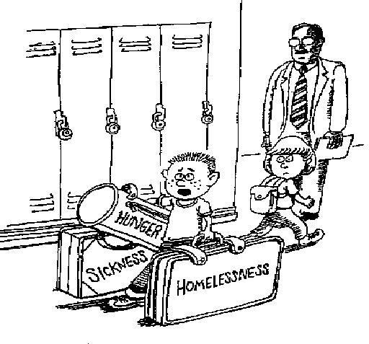
“Could someone help me with these?
I’m late for math class.”
Scott Spencer
Notes:
Kids, just like adults, don’t show up at school automatically ready to learn. They bring with them all sorts of baggage and issues that are getting in the way of good learning.

Slide 6
Definitions

Slide 7
A Strategy for What?
A strategy for organizing the resources of the community around student success…
Pat Harvey, Former Superintendent
St. Paul Public Schools

Slide 8
What is a Community School?
A community school is both a place and a set of partnerships between the school and other community resources. Its integrated focus on academics, services, supports and opportunities leads to improved student learning, stronger families and healthier communities.
Coalition for Community Schools

Slide 9
Another Definition…
A community school is characterized by:
Extended Services
Extended Hours
Extended Relationships (“swinging door”)

Slide 10
Conventional
School
Community
School
Notes:
A rotary phone is a uni-tasker, in that it can only make and receive phone calls. At one point, that’s all that we needed and it served us well.
This is not to say that Community Schools is a new idea…rather, the concept has been around for over a century, starting with our settlement houses and industrial schools, and the linking of them to Boys and Girls Clubs and other programs and services that were not traditionally part of the school day.
The world has changed, however, and we need more functionality. A community school is more like a smart phone, in that in addition to making and receiving phone calls, it adapts according to the needs of the user.
It’s an operating platform through which to get many things done
It has apps that can be loaded, upgraded and which relate to one another
It’s a networked device than can interact with other devices
Etc., Etc.
A community school is a smart school

Slide 11
CAS Developmental Triangle
CORE INSTRUCTIONAL PROGRAM
Community
EXPANDED LEARNING OPPORTUNITIES
Family
Child
COMPREHENSIVE SUPPORT SERVICES

Slide 12
A Closer Look "The active ingredient in the environment that's having an influence on development is the quality of the relationships that children have with the important people in their lives. That's what it's all about". Jack P. Shonkoff, M.D.

Slide 13
Well-known models of Community Schools:
Beacons
Bridges to Success (United Way )
Children’s Aid Society Community Schools
Communities in Schools
Community Learning Centers (Cincinnati, OH)
Healthy Start
Polk Brothers Full-Service Schools
Schools of the 21st Century (Yale University)
University Assisted Schools –WEPIC -University of Pennsylvania

Slide 14
Underlying Research Base
Making the Most of Non-School Time
Reginald Clark
Milbrey McLaughlin
Deborah Vandell
Executive Function
Jack Schonkoff
Judy Willis
Sam Wang
Whole Child Approach/ Developmental Knowledge/
Jacquelynne Eccles
James Comer
Parents’ Active Role
Epstein (six types)
Henderson and Mapp
Harvard-FINE network
NCPIE
Coordinated Services
Fritz Ianni
Consistent Adult Guidance & Support
Werner/Benard (resilience theory)
Notes:
Jack P. Shonkoff, M.D. is the Julius B. Richmond FAMRI Professor of Child Health and Development and founding director of the university-wide Center on the Developing Child at Harvard University. He also chairs the National Scientific Council on the Developing Child, a multidisciplinary collaboration comprising leading scholars in neuroscience, developmental psychology, pediatrics, and economics, whose mission is to bring sound and accurate science to bear on public decision-making affecting the lives of young children.
Dr. Shonkoff chaired the Committee on Integrating the Science of Early Childhood Development for the Institute of Medicine and the National Research Council, and coedited its final report, "From Neurons to Neighborhoods: The Science of Early Childhood Development."
Judy willis,
Dr. Sam Wang, Pri
http://www.welcometoyourbrain.com/

Slide 15
Newer Research
Tony Bryk - successful schools in Chicago:
Principal: driver of change; inclusive leadership approach
Real family and community engagement
Ability to build professional capacity
Student-centered school climate
Coherent curriculum
Charles Basch - causal links between health issues and educational achievement:
Poor vision
Asthma
Teen Pregnancy
Aggression and Violence
Physical Inactivity
ADHD
Hunger (especially insufficient breakfast)

Slide 16
Newest Research
Ellen Galinsky – Mind in the Making:7 Essential Life Skills
Focus & Self Control
Perspective Taking
Communication
Making Connections
Critical thinking
Taking on Challenges
Self Directed, Engaged Learning
Paul Tough-How Children Succeed Qualities that matter most have less to do with IQ and more to do with character, like:
Grit
Curiosity
Conscientiousness
optimism
Notes:
Gallinsky
Collaborating with top researchers in the science of childhood brain development for the past decade, she identifies seven life skills that help children reach their full potential and unleash their passion to learn. The skills are presented in a readable and accessible volume enlivened by parents' narratives about what works and what doesn't, hints and tips, and over a hundred suggestions (games and family activities) for involving kids in the pursuit of learning. Each of seven chapters focuses on one skill, most of them involved with the executive (or management) function of the brain, such as focus and self-control, communicating, and critical thinking. Galinsky urges parents to instill in their children a grasp of different kinds of knowledge to best tap inborn sense and foster self-motivation. The big message is simple: teaching children to think may be the most important thing a parent can do.
Tough
How Children Succeed introduces a new generation of scientists and educators who are radically changing our understanding of how children develop character, how they learn to think, and how they overcome adversity. It tells the personal stories of young people struggling to stay on the right side of the line between success and failure. And it argues for a new way of thinking about how best to steer an individual child — or a whole generation of children — toward a successful future.

Slide 17
Key Ingredients
Education First/Student Success as the Driver
Full-Time Coordinator
Site-Based Needs Assessment
Responsive Community Partnerships
Integration of CS Staff into Governance and Decision-Making Bodies (e.g., School Leadership Team, Principal’s Cabinet)
Ongoing Joint Planning and Data Analysis

Slide 18
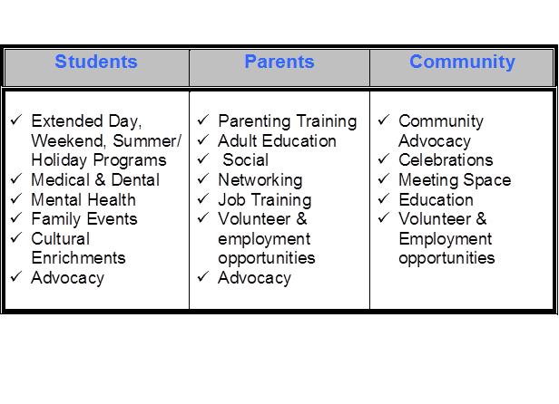
Key Program Components
Cradle to Career: birth, infancy, Early Childhood; School-Age; College; Career ; Workforce Development
Community and Economic Development

Slide 19
Results of CAS Community Schools
Improved academic performance—ELA and Math
Higher attendance rates—Students and Teachers
Positive school climate
Improved school safety
Greater parent involvement
Improved student-teacher relationships
Community benefits, such as better use of public buildings and safer neighborhoods
Teachers able to focus on education

Slide 20
National Movement
National Coalition for Community Schools founded in 1998
Cities and districts begin “going to scale”
Community school concepts embedded in Promise Neighborhoods, Collective Impact initiatives
Community schools support Extended Learning Time (ELT) initiatives
Community school language emerging in federal policy (Title I, Turnaround)

Slide 21
Capacities & Stages

Slide 22
Underlying Principles/Capacities
Comprehensiveness: Responding as fully as possible to the documented needs of students and families
Coordination: Structured and meaningful involvement of all stakeholders
Coherence: Supports/services are aligned (integrated) with the core instructional program
Commitment: Partners view CS as a long-term strategy, not a project, and do everything they can to make the partnership work

Slide 23
Stages of Development in a Community School
Exploring
Emerging
Maturing
Excelling
Notes:
Exploring – when we begin to learn, develop a plan, and reach out broadly across our communities to build our partnerships
Emerging – when we are beginning to put in place the staffing, management, governance structures and find the resources to offer programming and services.
Maturing – when we are continuing to plan, raise funds, and integrating our practices into the work of the school
Excelling – when we are continuously improving, adapting, developing new leaders and teaching others the CS strategy

Slide 24
Our Three Mantras
It’s all about relationships
Everything has to be negotiated—all the time
For community schools to work, the partners have to have the word “yes” written in their hearts

Slide 25
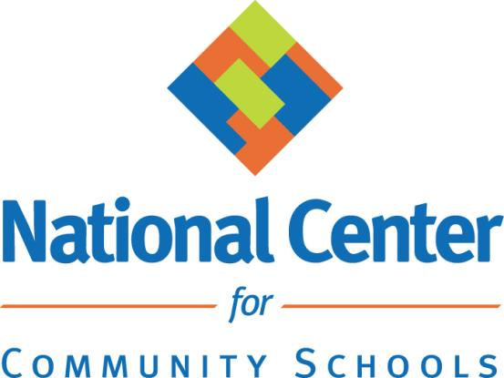
nationalcenterforcommunityschools.org

