Slide 1
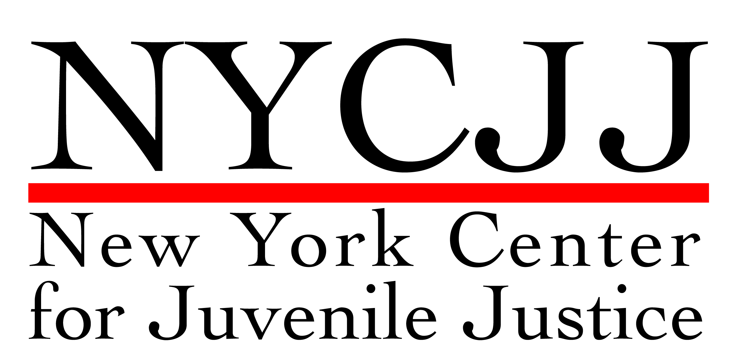
Unintended Consequences of School-Justice Practices

Slide 2
“Most school arrests were for minor, typical adolescent misbehavior that would not have resulted in arrest in a different school setting.”
“Students as young as 11 years old were arrested, while arrests most frequent among 16- and 17-year-olds for school-based incidents.”
Keeping Kids in School and Out of Court Report and Recommendations New York City School-Justice Partnership Task Force

Slide 3
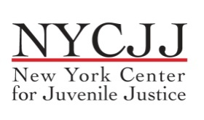
Three Laws
Age of Criminal Responsibility
The Juvenile Offender Law
Youthful Offender Law

Slide 4
Penal Law Section 30 establishes sixteen as the general age of criminal responsibility.

Slide 5
Youthful Offender Treatment
Criminal Procedure Law Section 720.20(1)(a): “If in the opinion of the court the interest of justice would be served by relieving the eligible youth from the onus of a criminal record and by not imposing an indeterminate term of imprisonment of more than four years, the court may, in its discretion, find the eligible youth is a youthful offender.”

Slide 6
“From a moral standpoint it would be misguided to equate the failings of a minor with those of an adult, for a greater possibility exists that a minor’s character deficiencies will be reformed.”
Ropers v. Simmons 543 U.S. 551 U.S. 551(2005)

Slide 7
Adolescent Sentencing Policy
“The principal objective of policy in the adjudication and sentencing of minors is to avoid damaging the young person’s development into an adulthood of full potential and free choice. Thus, the label for this type of policy is ‘room to reform.’”
Frank Zimring

Slide 8
Judicial Responsibility/The Role of the Judge Resolving Cases Involving Adolescents
“In these new courts, judges are active participants in a problem-solving process…. What's so different about this approach?
First is the court's belief that we can and should play a role in trying to solve the problems that are fueling our caseloads.
Second is the belief that outcomes--not just process and precedents--matter….
Third is the recognition that courts' coercive powers can change people's behavior….”
Chief Judge Judith Kaye (Ret.)

Slide 9
Key Principles in the Adjudication of Cases Involving Adolescents
Cultivate the ability to engage with young people
Recognize and integrate the malleability and resiliency of adolescents in dispositional recommendations.
Cultivate a reintegrative/restorative approach to dispositions
Cultivate a recognition of the redemptive quality of children.
Cultivate the right attitude

Slide 11
“If due process values are to be preserved in the bureaucratic state of the late 20th century, it may be essential that officials possess passion, the passion that puts them in touch with the dreams and disappointments of those with whom they deal, the passion that understands the pulse of life beneath the official version of events.”
-Supreme Court Justice William J. Brennan Jr.

