Slide 1
A Model Code on education and dignity
Harold Jordan
Dignity in Schools Campaign (DSC)

Slide 2
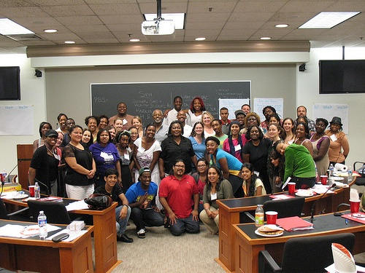
Dignity in Schools Campaign (DSC)
Challenges the systemic problem of pushout and advocates for the human right of every young person to education and dignity
79 organizations from 22 states:
Youth and parent groups
Legal and advocacy groups
Teachers and educators
Researchers

Slide 3
DSC Model Code
Model policies for schools, districts and legislators to address school pushout and create safe and positive climates for learning
Based on research, best practices and on the ground experiences of students, parents and educators
Rooted in fundamental human rights principle that the goal of education is to develop each young person to their full potential
Notes:
3

Slide 4
Key Elements of School Climate & Discipline Policy
Establish Positive School Climate
Create positive physical environments
Adopt a Positive Approach to Discipline
School-wide Implementation: Restorative Practices & PBIS
Set clear expectations and graduated levels of interventions
District and school-level implementation teams
Build school community
Integrate social-emotional learning
Require access to education during removal
Limit exclusion to only the most serious offenses
Require positive interventions before exclusion
Data, monitoring and evaluation
Training for staff, students and parents
Integration into teaching & responses to behavior

Slide 5
Example of Levels of Intervention (Greenville, MS)
Key: Use lowest level indicated first
Level 1: Classroom support – May be appropriate when the student has no prior incidents and interventions have not been put in place. | Level 2: RtI/IEP Team – may be appropriate when supports have been put in place in the classroom to address behavior but the behavior has continued to negatively impact the learning of the student and others
Level 3: TST, Intensive Support Staff, and Appropriate Administration – may be appropriate when school supports are needed to correct behavior | Level 4: Suspension (1-3 Days) and Referral – may be appropriate when interventions and supports have been put in place but the behavior is escalating (repeated offenses)
Level 5: Extended Suspension, (1-10 days) Expulsion, and Referral – may be appropriate when student’s behavior seriously impacts the safety of others in the school
Note: On the first instance of an inappropriate or disruptive behavior, use one or more intervention from the lowest level indicated for that behavior, or any lower level. If the same behavior is repeated during the same school year, one or more interventions or disciplinary responses from the next highest level may be used. Lower-level interventions may always be used, but interventions or disciplinary responses from the shaded boxes may never be used.
Inappropriate or Disruptive Behavior |  | Levels 1 2 3 4 5
Classroom Disruptions (e.g., talking out in class or talking out of turn, throwing objects, and other behavior that distracts from student learning) | ● | ● | ●
Dress code violation | ● | ●
Fighting Physical aggression - No injury(e.g., pushing and shoving) More serious fighting (may include incidents involving minor injuries) |  | ● | ● | ● ● |  | ●

Slide 6
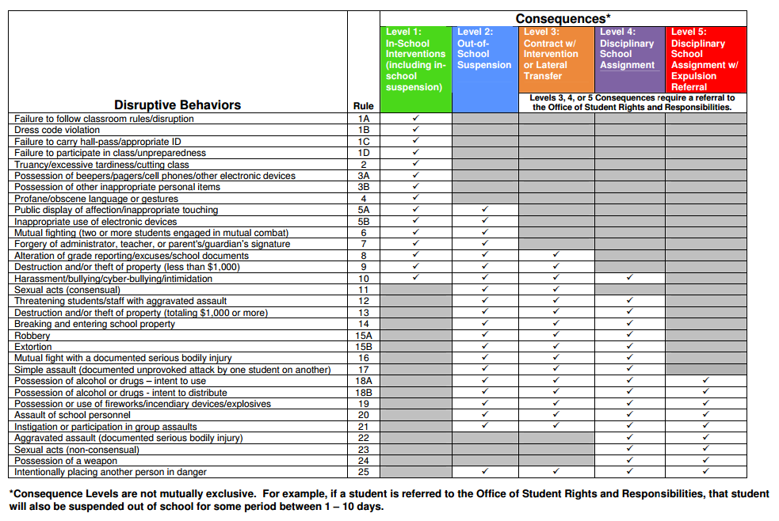
Philadelphia (PA)

Slide 7
Using the Model Code
Identify which sections of the Code are most relevant to your community or school
Compare the Model Code to the existing law or policy
Use “recommended language” from the Code to help shape policy changes
Use guidelines in the Model Code to assist with implementation
15

Slide 8
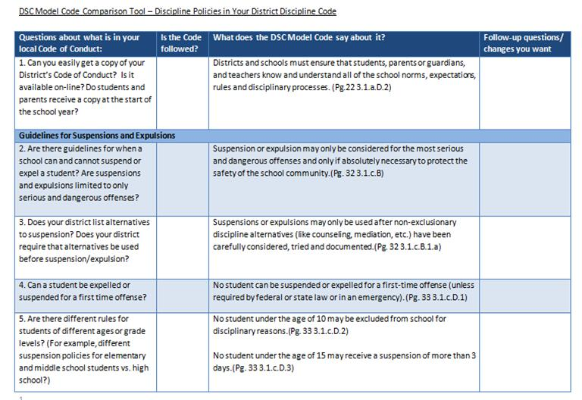
Breakout Session
James Payne, Alliance for Quality Education and Citizen Action of New York, will share his experience reforming Buffalo’s Discipline Code
Walk through the DSC Model Code Comparison Tool

Slide 9
Resources for Using the Model Code
http://www.dignityinschools.org/our-work/model-school-code
Executive Summary and Model Code by Section
Discipline Code Comparison Tool (breakout session)
Community Toolkit and Workshop Exercises
Tips for sharing the Code with policy-makers, students, parents, educators and communities
Sample activities for holding workshops on the Code
List of resources (reports, model laws and policies, etc.) to help in implementing the Code
Participate in Model Code Webinars or Hold a Training
Email: info@dignityinschools.org
16

