Slide 1
Educating the whole child for tomorrow’s challenges: the school climate improvement Process
Richard Cardillo
Director of Education
National School Climate Center

Slide 2
School climate improvement: Past and current efforts
School climate: An educational tradition
A data-driven, continuous school improvement strategy that recognizes the “voice” of the whole school community
Recognizing the social, emotional and civic as well as intellectual aspects of learning and school life
Supporting the “whole village” to support the whole child
School climate: An educational tradition
A data-driven, continuous school improvement strategy that recognizes the “voice” of the whole school community
Recognizing the social, emotional and civic as well as intellectual aspects of learning and school life
Supporting the “whole village” to support the whole child
Notes:
• an educational focus for over 100 years
• School climate – the quality and character of school life that is based on patterns of student/parent/school personnel: norms, values, expectations, relationships, beliefs, teaching/learning, leadership
• A continuous improvement model that explicitly recognizes (i) the “voice” of students, parents/guardians, school personnel and even community members and (ii) the social, emotional and civic as well as intellectual aspects of student learning and school life

Slide 3
A working definition
“School climate refers to the quality and character of school life. School climate is based on patterns of people’s experience of school life and reflects norms, goals, values, interpersonal relationships, teaching, learning, leadership practices, and organizational structures.”
-National School Climate Council, 2007
Notes:
Definitions matter!
• Definitions reflect our understandings
• Understandings (or misunderstandings) shape our goals
• Goals shape our behavior as they result in methods, instructional strategies and/or school-wide improvement efforts that we utilize to actualize our goals

Slide 4
School Improvement Research: helpful and less helpful “Drivers” of change*
Unhelpful Primary Drivers:
Accountability systems that use data as a “hammer” rather than a “flashlight”
Primary focus on the individual teacher and/or administrator
Technology
Specific “evidence-based” programs
“One-Time” programs
Helpful Primary Drivers
Fostering the intrinsic motivation of students, parents and school personnel: “igniting” the process
Engaging students & educators in a continuous process of social-emotional & civic as well as intellectual learning
Inspiring team work and a collaborative problem solving process
Affecting the whole community
* Bryk, et. al. 2002 & 2010; Fullan, 2011; Mourshed, Chijioke & Barber, 2010; Tucker 2011.
Notes:
• Current improvement efforts in America tend to focus on the four UNHELPFUL drivers of change.
• School Climate Reform recognizes and supports all of the helpful drivers of change.

Slide 5
“…so, on what page of the guide can I find this stuff?”
How do we move from speaking about school climate to doing school climate?
How do we measure school climate?
How do we link our measurements to the school climate improvement process?

Slide 6
Traditional Approach to Change
Research
Policy
Practice
Notes:
In the traditional approach, we generally see educational change occurring with research shaping policy. And then we see policy dictating our practices. School climate improvement efforts tend not to be so linear.

Slide 7
School Climate Improvement Efforts rely on these drivers:
1. Inclusion
Who’s invited to the table?
2. Infusion
How do we get inside the DNA of our building?
3. Deep Dives & Risk Taking
Where has “window dressing” ever gotten us?
“Best” Practices to “Next” Practices.
4. No Fault frameworks and a culture of trust
How do we address the “non-discussables”?
5. Honor and promote student voice.
How can we “get out of the way”?
Notes:
In contrast, let’s look at ways that school climate improvement efforts take hold. Certain drivers will ensure that we embark on this “voyage” from an asset-based perspective rather than a deficit-based perspective.

Slide 8
Essential Questions
How safe, supported and engaged do your students feel?
How do you know?
Response to these two questions will begin the measurement/assessment process.
Notes:
As we do with most learning design models, let’s pose some essential questions.
How do you think students perceive their school? Their safety? Their “voice”?
How are you sure of that?
What are some indicators that you would suggest give you reason to believe what you believe?

Slide 9
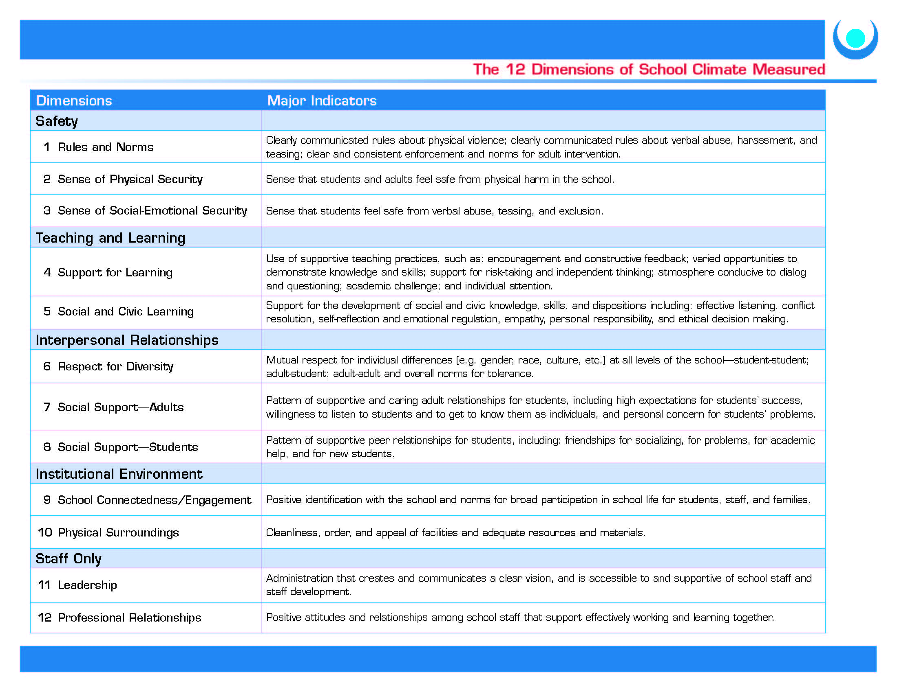

Slide 10
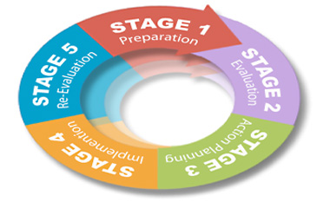
Five-Stage School Climate Improvement Process
Notes:
the SC Improvement process is – on one level – the familiar problem solving cycle that characterizes and shapes all school reform efforts. However, our Center has synthesized research and best practices from a series of fields (school reform in general as well as character education, SEL, community schooling, service learning, risk prevention and health/mental health promotion to delineate a series of tasks and challenges that shapes each of these five stages. Engaging EVERYONE in the community is the foundation for effective school climate improvement efforts

Slide 11
What is a logical “game plan”?
1. Preparation
Forming a representative SC improvement leadership team and establishing ground rules collaboratively.
Skills Assessment & “Assigning the Proper Positions”
Building support and fostering a shared vision (or “Buy In”) for the school climate improvement process.
Practice & Drills
Establishing a “no fault” framework and promoting a culture of trust.
Ongoing Conditioning (“Stay Hungry”)
Ensuring your team has adequate resources to support the process.
Pep Rally
Celebrating successes and building on past efforts.

Slide 12
2. Evaluation
Systematically evaluating the school’s strengths, needs and weaknesses with any number of school climate (and other potential) measurement tools.
Developing plans to share evaluation findings with the school community.
Notes:
• Picking a school climate survey that ‘works’ for your school is one of the first steps here. It is essential that students and parents/guardians and school personnel.. And if at all possible community members be surveyed.
• SC assessment is a powerful engagement strategy: when all people report (on the surveys what they believe are the schools social, emotional and civic strengths and needs, this positions the Principal to say “I now know what you think and believe.” “I now need your help in prioritizing our goals, and then, carrying them out!”
• The other ‘big’ challenge here is that too many principals want to skip Stage one tasks (“please just tell me what the survey say, tell me what to do and how to do it!”). As busy as principals are, this is unhelpful. Stage one tasks create the foundation that allows us to use school climate evaluation findings.

Slide 13
3. Understanding the findings and developing an action plan.
Analyze your findings and give them context that is pertinent to your reality..
Many forms of data that you already have.
attendance
discipline referrals
graduation rates
teacher retention
parental involvement
Students as “action researchers”.
Digging into the findings to understand areas of consensus and discrepancy in order to promote learning and engagement.
Prioritizing Goals.
Researching best practices and evidence-based instructional and systemic programs and efforts.
Developing an action plan.
Notes:
• This stage provides exciting opportunities to engage youth as well as fellow educators and parents in the process of understanding, ‘digging deeper’ into the findings, prioritizing goals and developing action plans.
• the three most common school climate findings that we have discovered in our work with hundreds of schools across America are: (i) the adults report that safety is a “mild” to “moderately severe” issue for students, but students report that it is a “severe” problem; (ii) dis-respect for diversity is reported to be a major problem by all! And, (iii) educators tend to report that they are helpful and intentional social, emotional and civic as well as intellectual teachers. But, students and parents tend to rate them less favorably in this regard. (Here is one of the many instances where the adult culture (e.g. of trust or distrust) will so powerfully shape conversations and learning. In any case, students can and need to be co-learners and co-leaders in understanding these or any school climate findings. And, then developing goals and strategies to address these issues.

Slide 14
4. Implementing the Action Plan
Walking The Walk
Coordinating evidence-based pedagogic and systemic efforts designed to (a) promote students’ social, emotional and civic as well as intellectual competencies; and (b) improve the school climate by working toward a safe, caring, participatory and responsive school community.
Square Dancing
The instructional and/or school-wide efforts are instituted with fidelity, monitored and there is an ongoing attempt to learn from successes and challenges.
Waltzing & Dancing With the Stars
Considering and supporting how educators can align quality academic based service learning efforts with engaging school climate improvement efforts: they support one another in powerful ways!
The “Dance of Life”
The adults who teach and learn with students work to further their own social, emotional and civic learning.
Notes:
Implementing the action plan can be compared to preparing for a dance routine. We try to mold our movements to the capacity we have at the time. As time progresses, we re-define, refine, and choose more creative and complex ways of moving.

Slide 15
5. Reevaluation and Development of the Next Phase
“We shall not cease from exploration And the end of all our exploring Will be to arrive where we started And know the place for the first time.” ― T.S. Eliot, Four Quartets
Reevaluating the school’s strengths and challenges.
Discovering what has changed and how.
Discovering what has most helped and hindered to further the school climate improvement process.
Revising plans to improve the school climate.

Slide 16
Let us keep learning together Richard Cardillo Director of Education National School Climate Center rcardillo@schoolclimate.org Twitter: @richardcardillo www.schoolclimate.org

